Slide 1

Master Insurance Policy
Frequently Asked Questions & Strategic Overview: Group Purchasing Power, Risk Pooling, and Administrative Structure Under Dominion First
These Slides are for informational and educational purposes only. Consult a licensed insurance professional for coverage advice specific to your organization. SFBA assumes no responsibility for decisions made by individuals or churches regarding their participation and coverage.

Slide 2
Understanding the Structure
How collective group purchasing delivers substantial premium savings while safeguarding individual congregational property and liability needs.

Slide 3

Individual vs. Master Coverage
Individual Policy Level
Master Policy Umbrella
Each church retains its own distinct policy specifying coverage amounts, replacement values, and deductibles.
Combines total coverage across participating churches into a shared aggregate pool (e.g., 15 churches forming a $15M group).
Churches receive payments only up to their individual insured amounts and pay their premiums directly to KingsCover.
Claims apply against the broad collective total, dampening rate spikes and yielding volume discounts of 9–12%.
Individual coverage is not impacted by the aggregate amount, Master Coverage simply reduces premium rates.

Slide 4
Group Purchasing Power
9-12%
Significant Budget Savings
KingsCover projects an average 9% to 12% premium decrease for churches participating in the group Master Policy compared to standalone policies.
Estimated Premium Reduction
Because risk is distributed across an aggregate pool, churches gain the pricing tier of a large institutional account without forfeiting customized property terms.

Slide 5
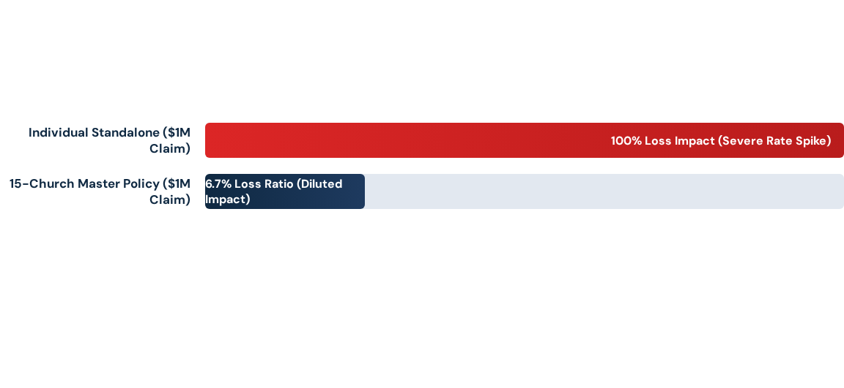
Single Claim Loss Ratio Impact
A $1M claim against a $1M individual policy triggers punitive renewal increases. Under a $15M Master Policy aggregate, the ratio is 1:15 instead of 1:1, minimizing overall rate volatility.

Slide 6





Individual Underwriting Factors
5-Year Loss History
Property Features
Geographic Location
Every church submits 5 years of declaration letters to establish individualized baseline pricing and risk exposure.
Specific rates reflect facility age, square footage, roof construction type, replacement cost valuation, and maintenance history, and other factors determined by the agent and underwriters.
Location attributes—including distance from coastal weather corridors and proximity to fire response—directly impact potential premiums.

Slide 7
Policy Structure Comparison
Key Consideration | Individual Standalone Policy | Master Policy Program
Purchasing Leverage | None (Solo church tier) | Bulk Institutional Tier (15+ Churches)
Single Claim Shock | High renewal rate volatility | Diluted impact across aggregate group
Expected Rate Trend | Standard annual market increases | Estimated 9–12% lower baseline cost
Administration | Managed entirely by local church staff | Program coordinated via Dominion First

Slide 8
Governance & Operations
Clear oversight, administrative authority, participation requirements, and catastrophe management protocols.

Slide 9

Dominion First Administration
Central Governance Role
The Master Policy is administered and governed by Dominion First, establishing the formal structure, compliance, and oversight necessary to protect member institutions.
Churches maintain direct billing and service channels with Dominion First, while Dominion First coordinates group requirements and ensures the stability of the aggregate umbrella.
SFBA will provide confirmation of member eligibility to Dominion First. Member churches in good standing will be eligible to participate in the Master Policy. Membership will be determined according to the governing documents of the SFBA.

Slide 10
Participation & Exit Rules
15-Church Minimum Requirement: Group bulk rates depend on reaching a minimum participation threshold. Target recruitment aims for margin well above 15 churches to ensure ongoing security.
Annual Departure Freedom: Participating churches are free to leave annually at renewal, though departing from the pool affects the remaining aggregate volume. If an individual church leaves the policy, they will no longer be guaranteed the Master Policy rate. Remaining member churches should not see a change in premiums until the annual renewal period when the new aggregate is established.
Financial Impact of Leaving: Withdrawing churches lose their group rate, incurring an estimated ~10% cost increase when transitioning to standalone coverage.
Underwriting Continuity: Some specialized church buildings face tight insurance markets; the Master Policy umbrella guarantees access to stable capacity.

Slide 11
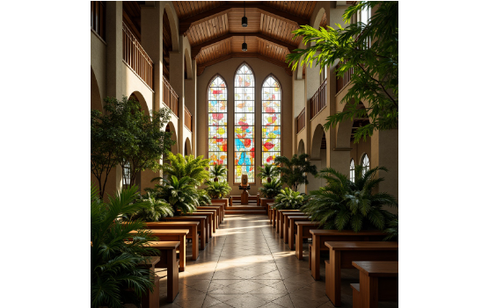
Catastrophe & Weather Risks
•
Severe coastal weather and hurricane exposures affect all regional properties regardless of insurance provider.
•
Widespread storms impacting multiple participating churches draw against the aggregate pool, affecting group-wide renewal loss ratios.
•
Individual deductibles, windstorm thresholds, and coastal proximity remain tailored to each specific church structure.
•
Dominion First works collaboratively with carriers to negotiate collective restoration and claims handling. Churches will not be able to enlist their own contractors for repairs; part of the cost savings is provided through Dominion First pre-negotiated relationships with general contractors.

Slide 12
Questions & Next Steps
Reviewing church declarations, confirming minimum participation, and scheduling one-on-one evaluations.
www.sfbatx.org/resources

Slide 13


Image Sources
https://images.squarespace-cdn.com/content/v1/527d3f3fe4b0aa5acd3f3be2/1737385564829-WY52QSHTUG2ZZGKJONPC/Enscape_2022-11-09-14-18-12.png
Source: www.vesselarchitecture.com
https://gstatic1.promeai.pro/gallery/publish/2024/11/24/ae919f8687c94080b9386d5de79a9533.jpg
Source: www.promeai.pro

